Slide 1
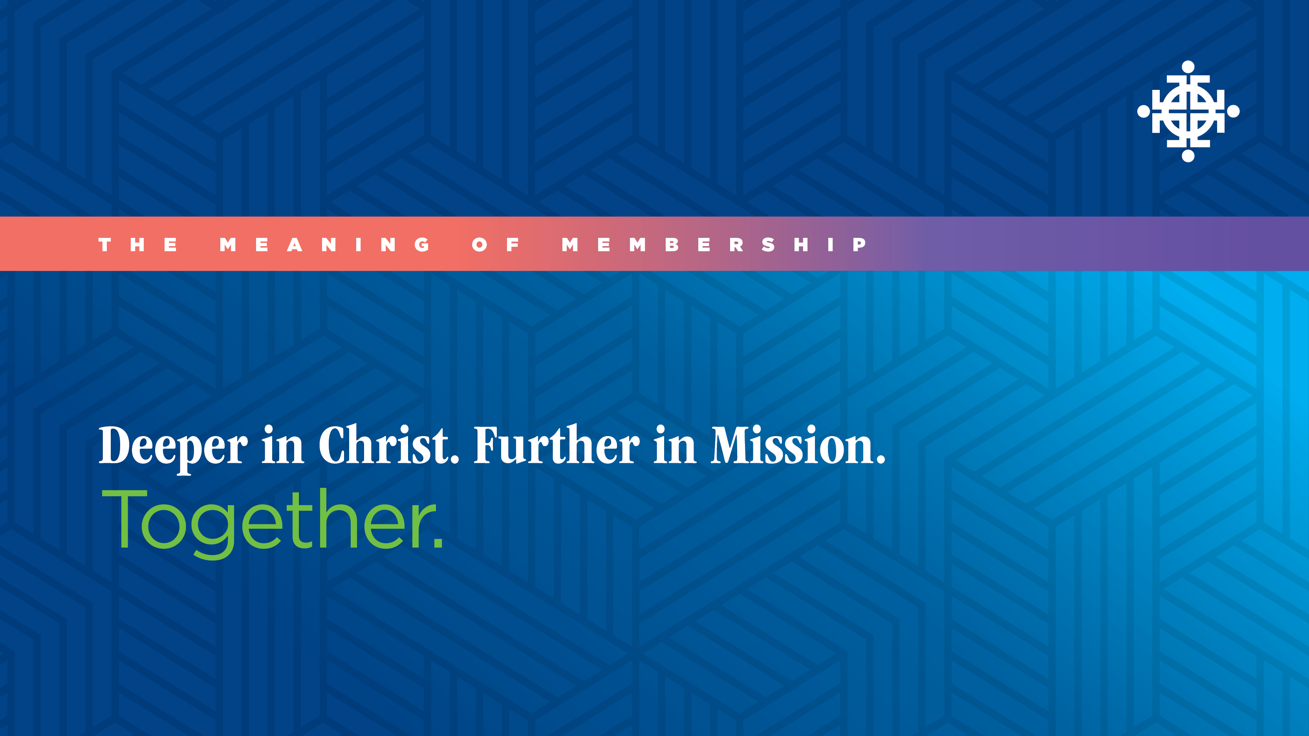

Slide 2
SESSION FOUR
The Mission of a Member

Slide 3
OBJECTIVES
Learn about your role as potential
members of (insert your church name).

Slide 4
Discussion Starter

Slide 5
WHY JOIN A CHURCH?
What are some reasons to join a local church?

Slide 6
REASONS FOR JOINING THE CHURCH
• Joining the church honors Christ.
• Joining the church is missional.
• Joining the church fosters spiritual growth.
• Joining the church is ethical.
• Joining the church is counter-cultural

Slide 7
What does it mean to be a member?

Slide 8
GROWING AS CHRIST’S DISCIPLES
Our commitment is to help you go deeper
in Christ and further in mission together.
These commitments remind us how we can grow.
• Biblical
• Devotional
• Connectional
• Missional

Slide 9
REFLECTION
• How have you already experienced
growth in these four areas during your
time in this church community?
• How can we best empower you to
grow further in each of these areas?

Slide 10
BEING A PART OF GOD’S KINGDOM
• Jesus spoke of God’s kingdom.
• God’s kingdom is not like any earthly kingdom.
• As disciples of Jesus Christ we are
ambassadors of God’s kingdom.

Slide 11
REFLECTION
How can being a member of the church help
us live into the kingdom together and help us
to be the kind of disciples Christ calls us to be?

Slide 12
SEEKING TO FULFILL THE WILL OF GOD
Together we:
1. Strive for spiritual health as a church
2. Serve together in ministry as a church
3. Support the mission of our church

Slide 13
GROUP REFLECTION AND DISCUSSION
1. There are many ways that we seek to fulfill
God’s will. Which are you most drawn to?
2. What are your thoughts about this lifelong
journey and the ways in which we minister
together to fulfill God’s will?
3. Does today’s session raise any particular
questions, concerns, or other feelings for you?

Slide 14
Decision to Become a Member

Slide 15
NEXT STEPS TOWARD BECOMING A MEMBER
(insert your church text and images here)

Slide 16
IF YOU DECIDE NOT TO BECOME A MEMBER
(insert your church text and images here)

Slide 17
CLOSING
• What are your closing thoughts as we
end this discussion?
• Would any of you be willing to share about
what this church has meant to you so far
and what you hope to experience in the future?

Slide 18
Next Steps

