Slide 1
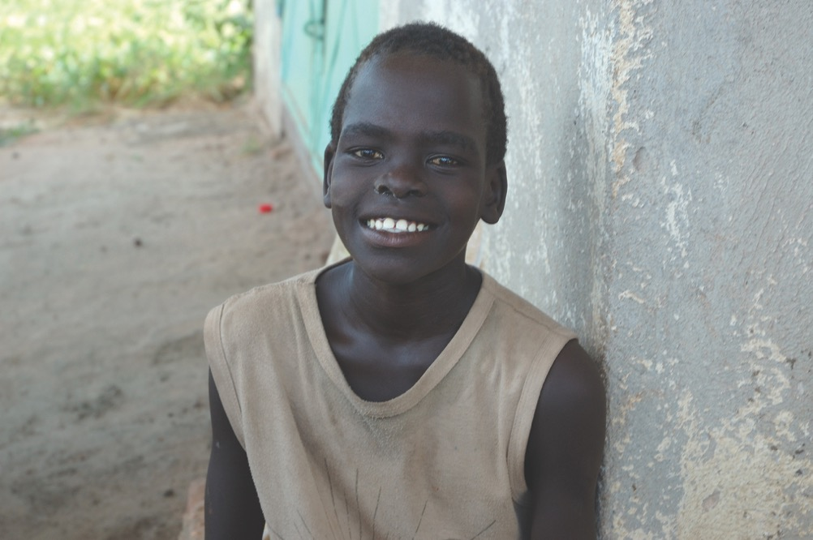

Slide 2
South Sudan

Slide 3
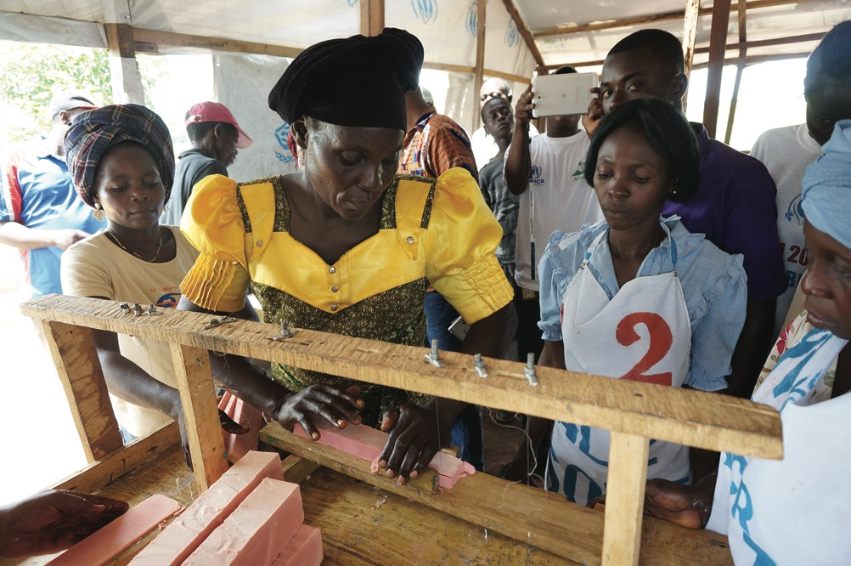

Slide 4
Central African Republic
DR Congo

Slide 5
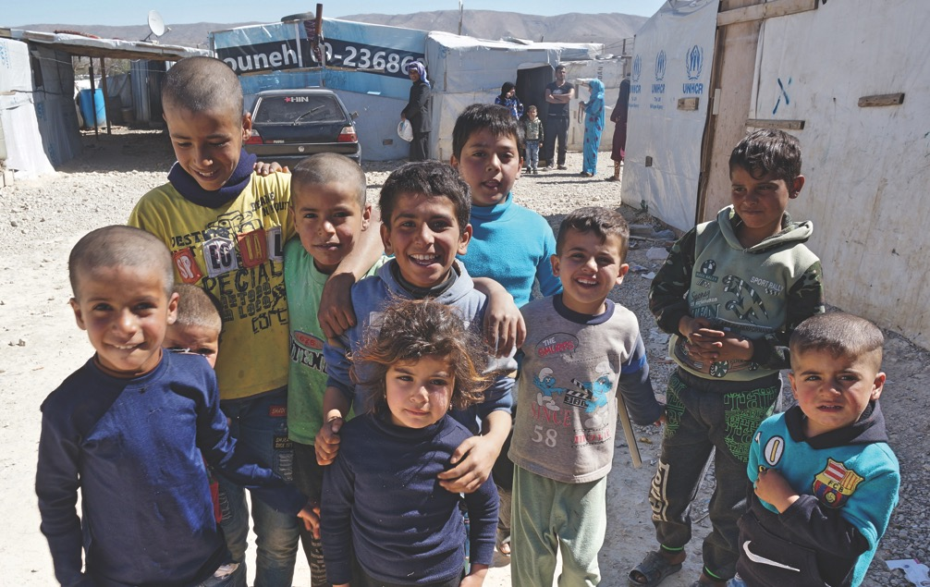
SYRIAN REFUGEE CHILDREN

Slide 6
United States of America
Syria

Slide 7
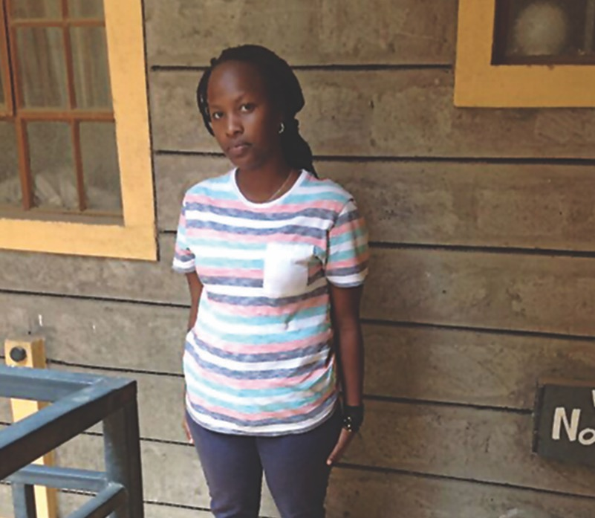

Slide 8
Kenya
DR Congo

Slide 9
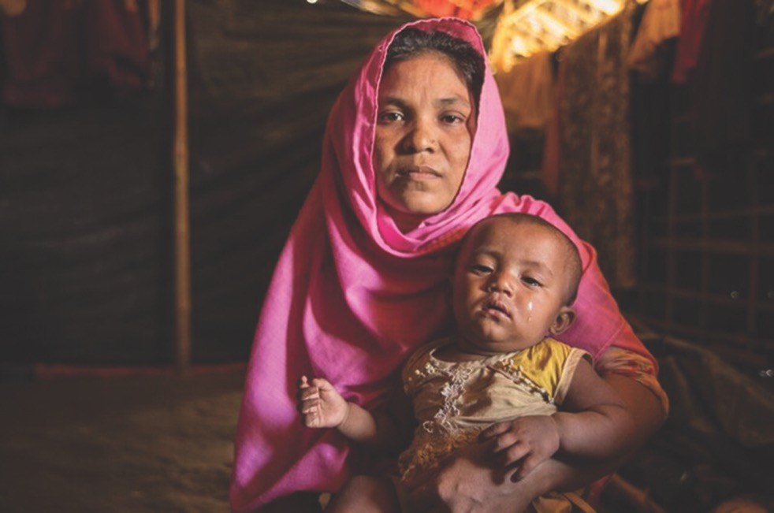
Photo courtesy of Medical Teams International

Slide 10
Myanmar
Bangladesh

Slide 11
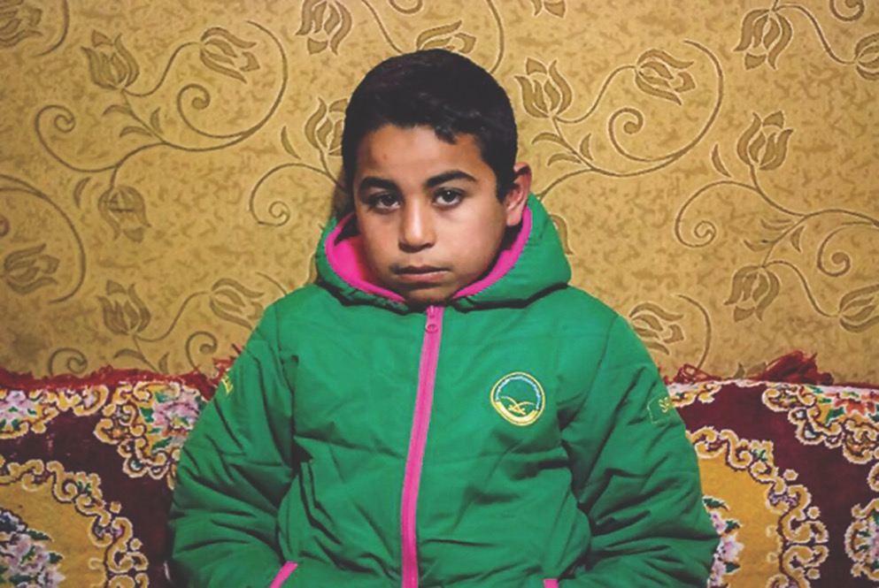
Photo courtesy of Medical Teams International

Slide 12
Lebanon
Syria

Slide 13
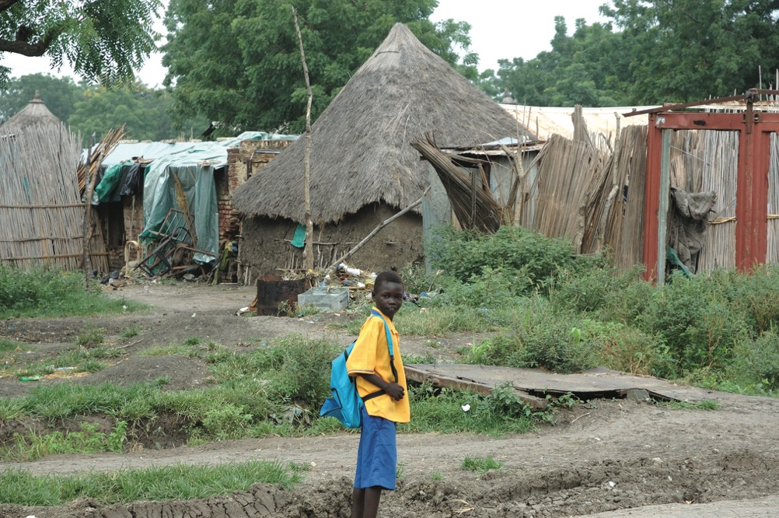
Photo courtesy of Medical Teams International

Slide 14
South Sudan
Kenya

Slide 15
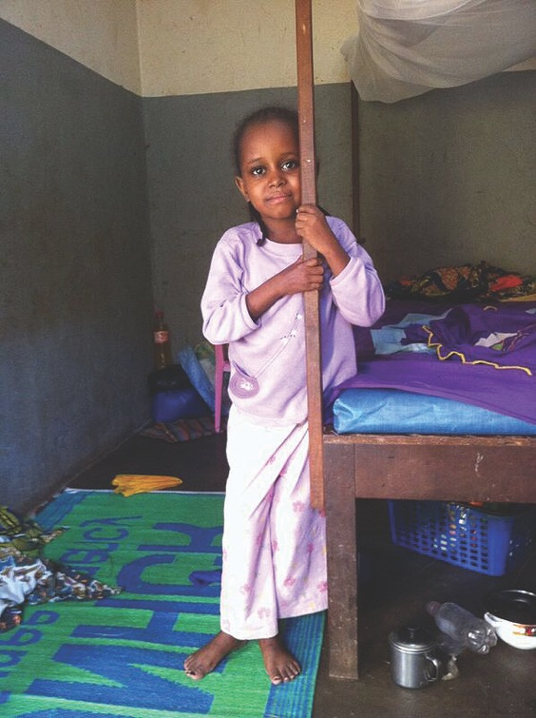

Slide 16
Central African Republic
Cameroon

Slide 17
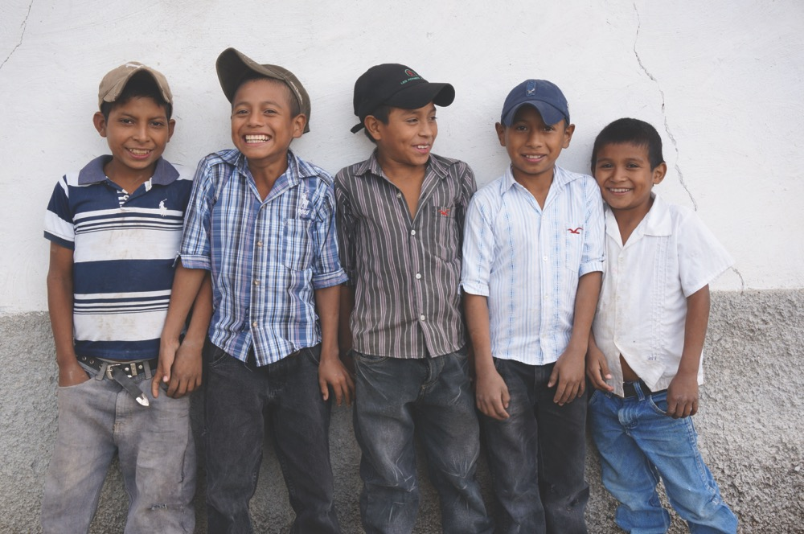
HONDURAN CHILDREN

Slide 18
United States of America
Honduras

Slide 19
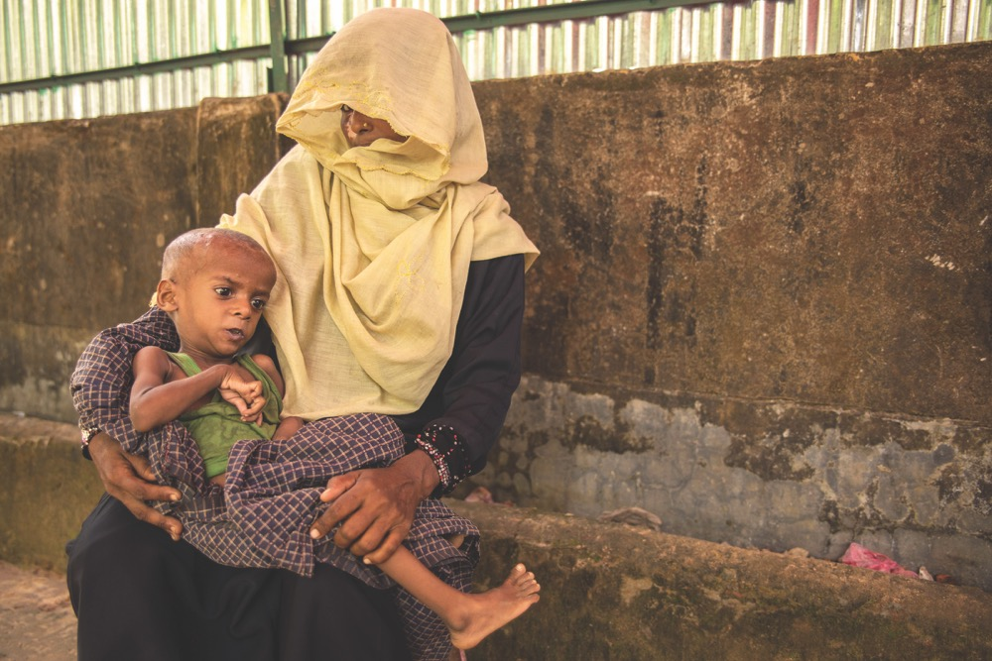
Photo courtesy of Medical Teams International

Slide 20
Bangladesh
Myanmar

Slide 21
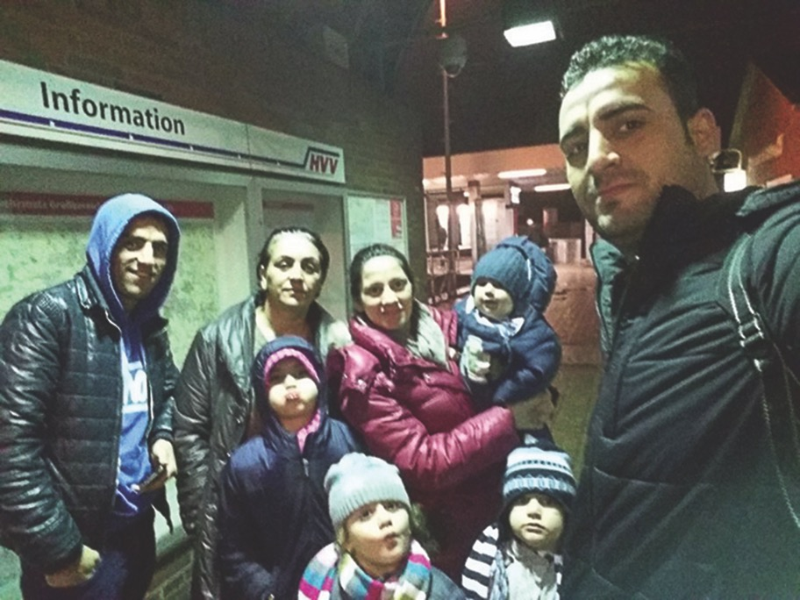

Slide 22
Germany
Iraq

Slide 23
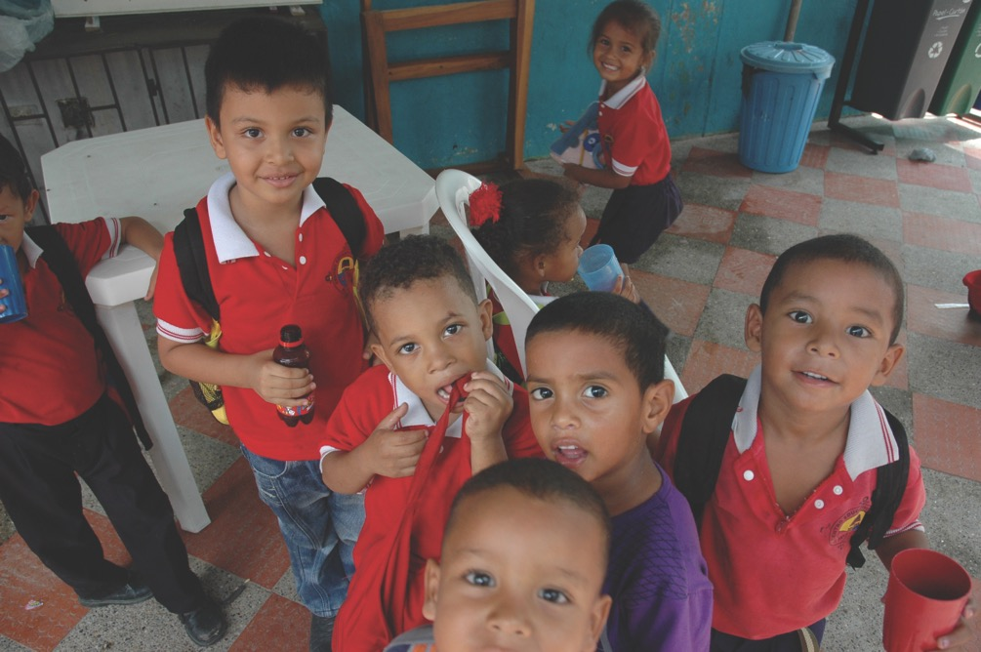
(Internally Displaced Person)
COLOMBIAN CHILDREN

Slide 24
Colombia
(Internally Displaced Person)

