Slide 1
Emmanuel’s Story
PEACEMAKING IN SOUTH AFRICA

Slide 2
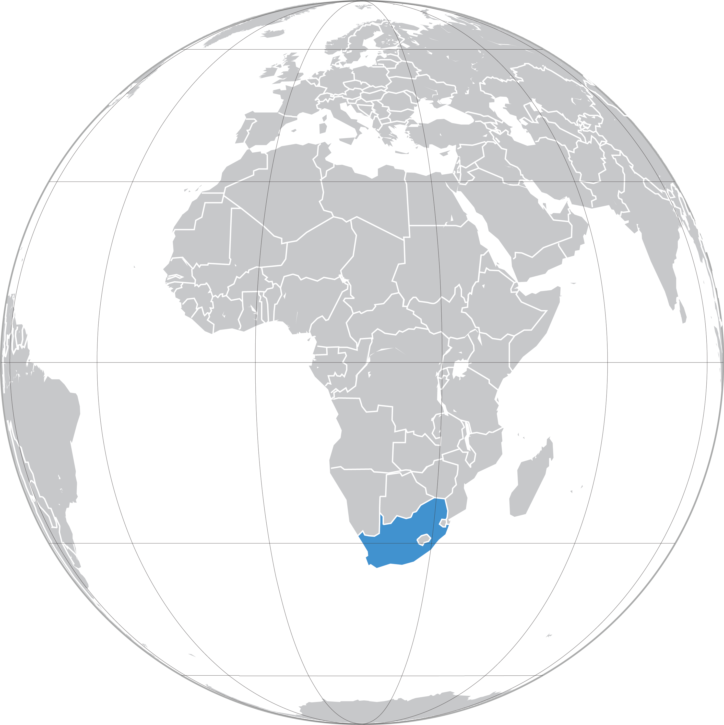
Emmanuel’s Story
PEACEMAKING IN SOUTH AFRICA

Slide 3
Quri’s Story
PEACEMAKING IN ECUADOR

Slide 4
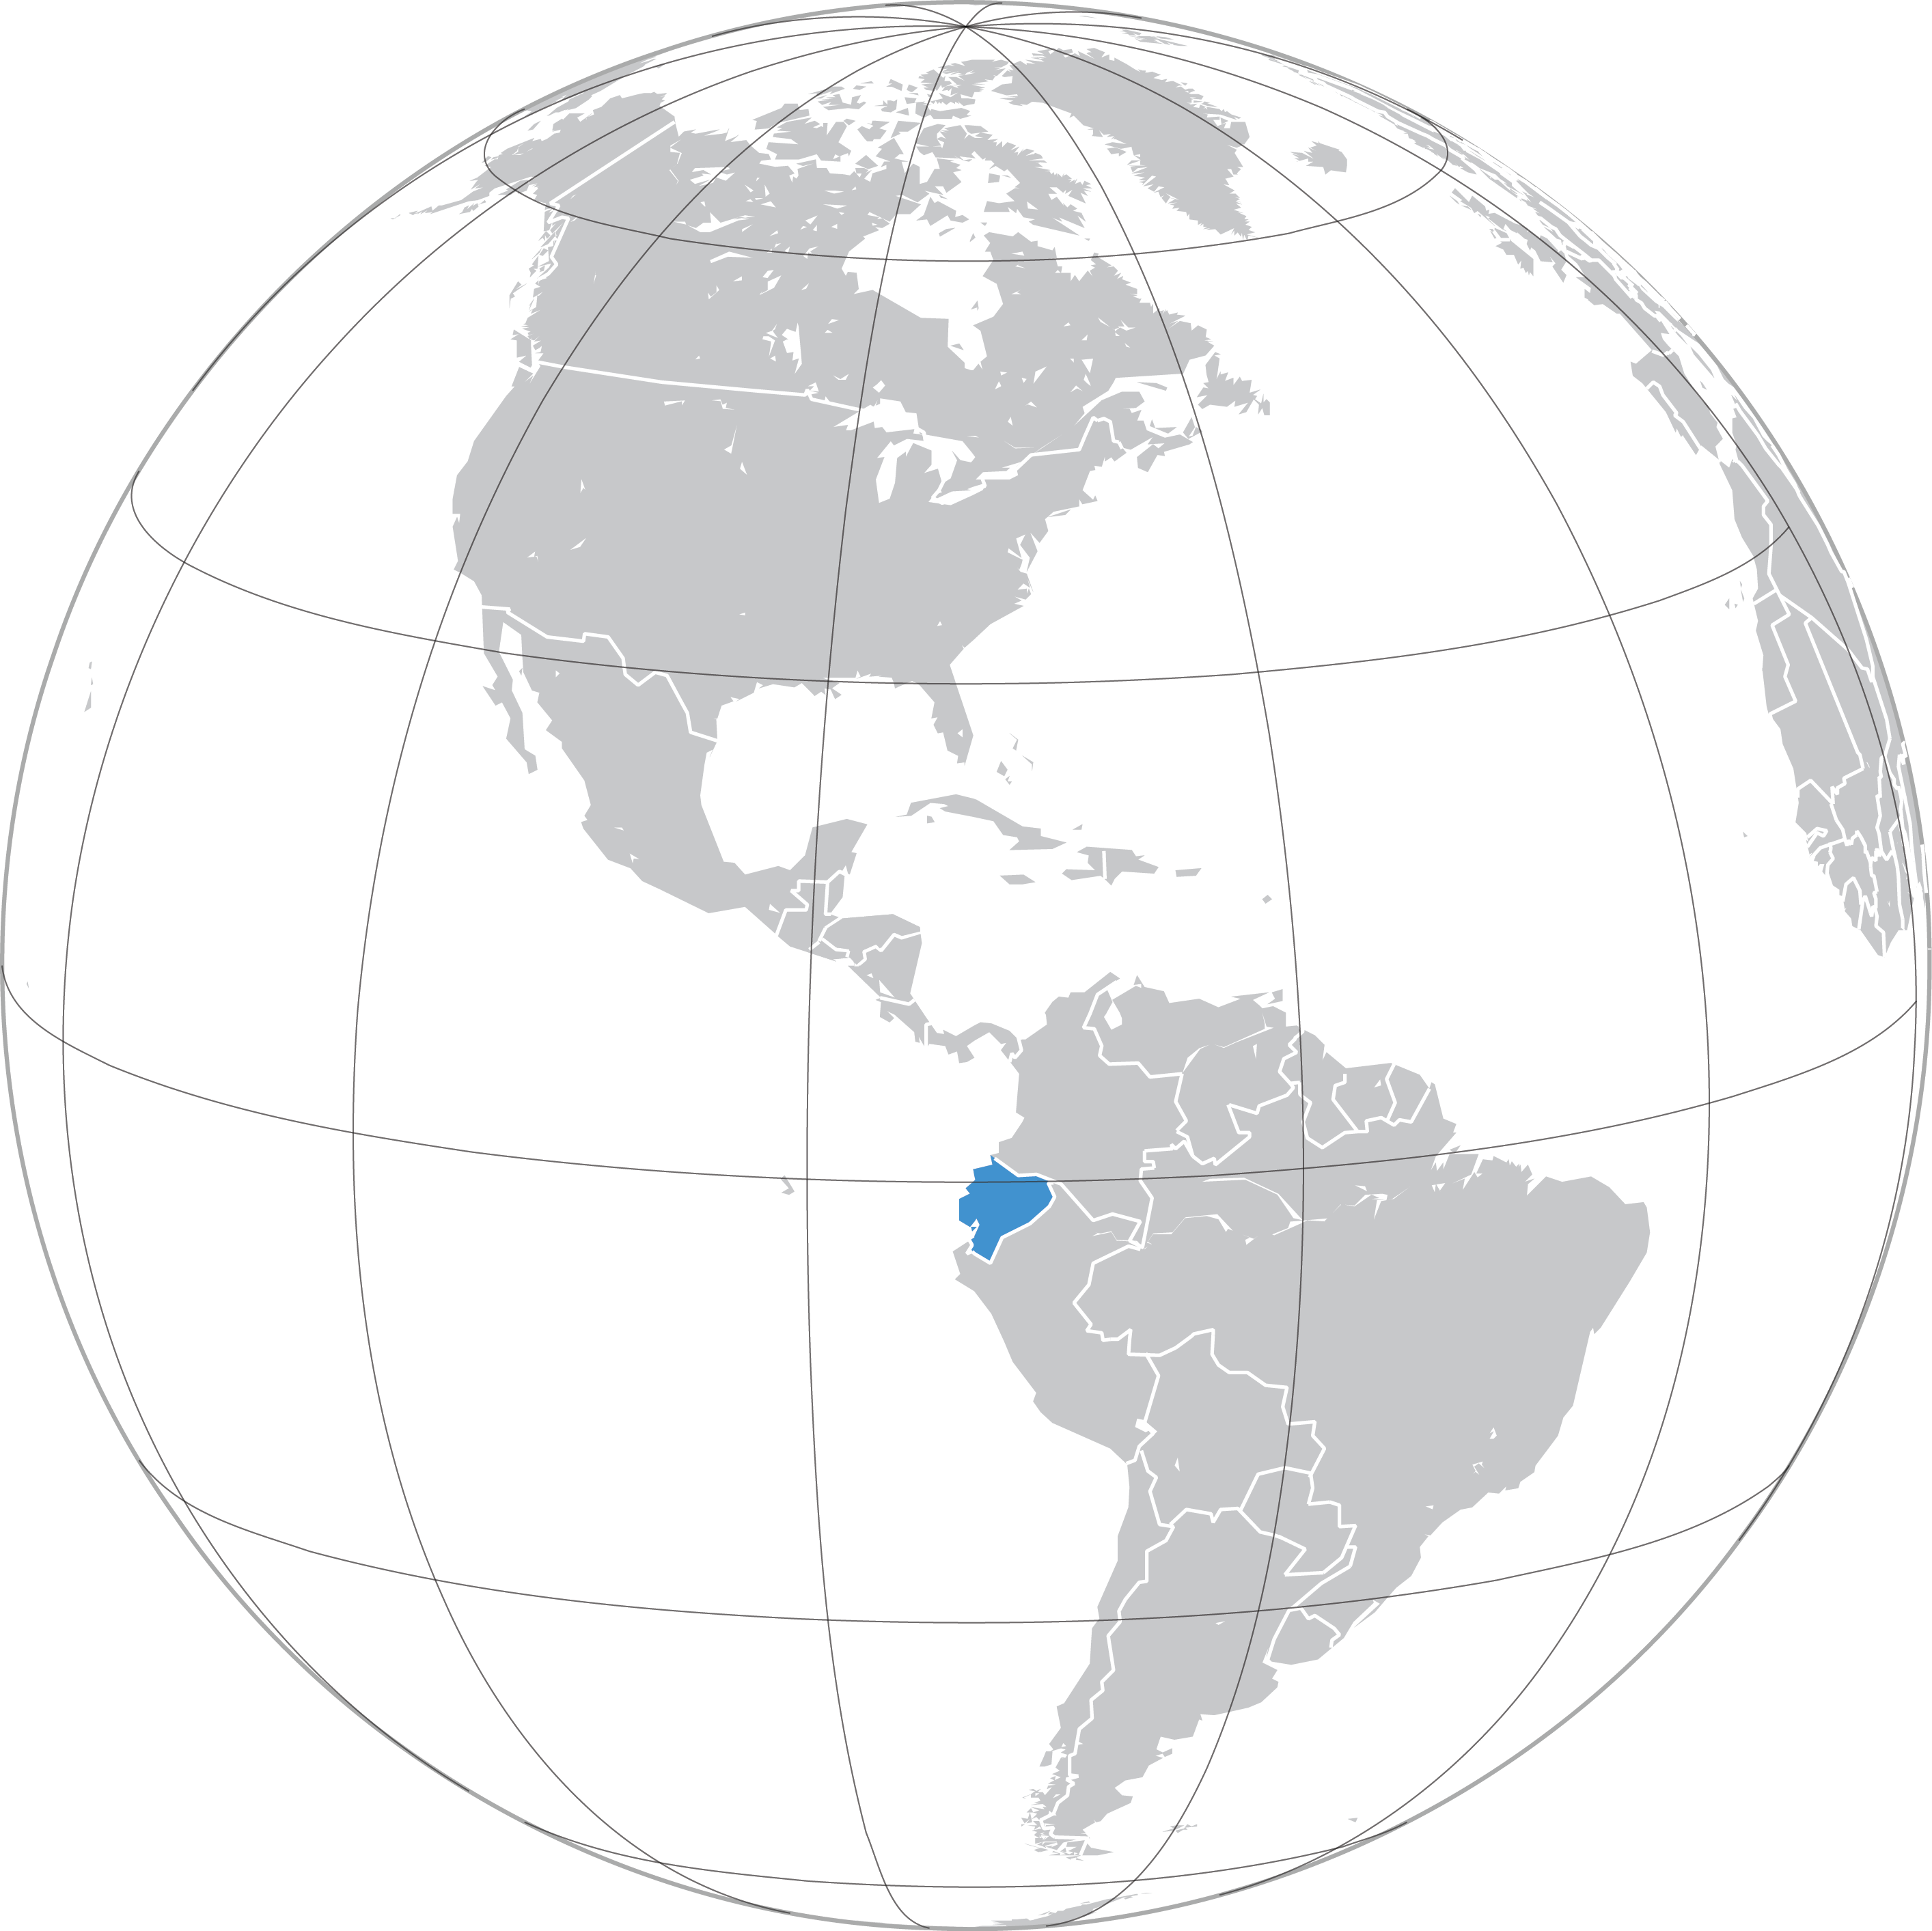
Quri’s Story
PEACEMAKING IN ECUADOR

Slide 5
Levis’s Story
PEACEMAKING IN KENYA

Slide 6
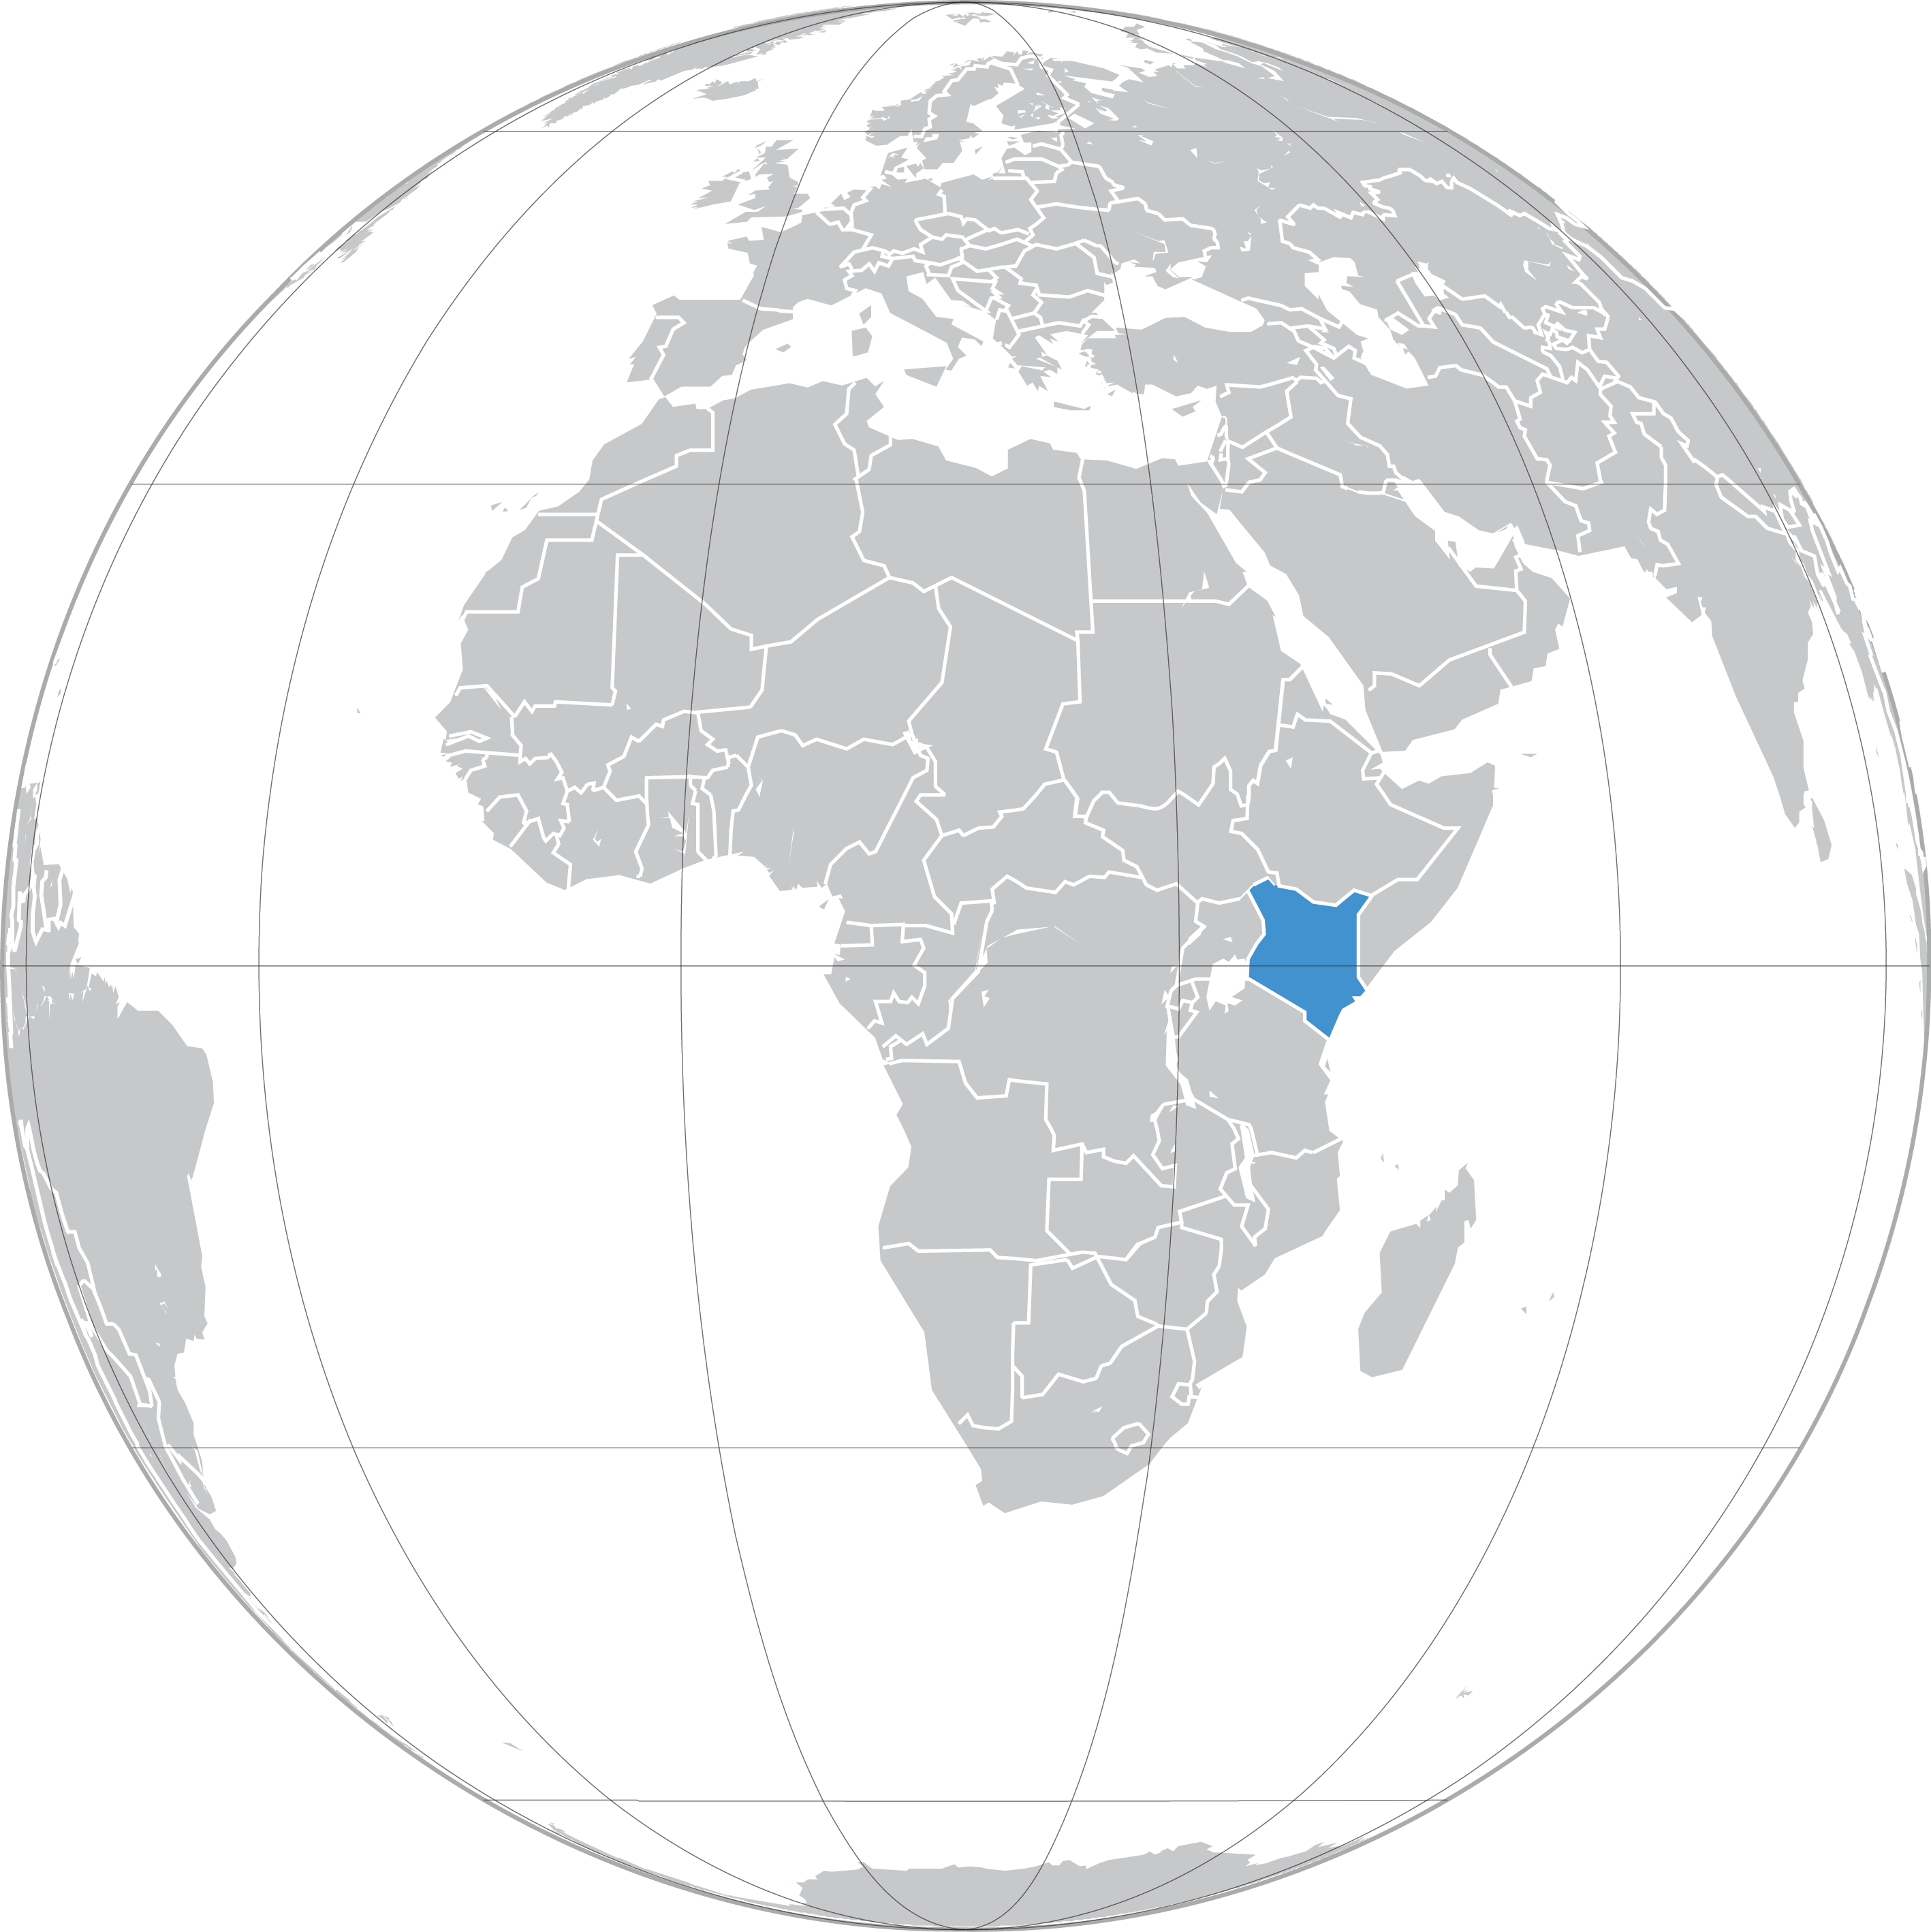
Levis’s Story
PEACEMAKING IN KENYA

