Slide 1


A SERVE GLOBALLY RESOURCE

Slide 2
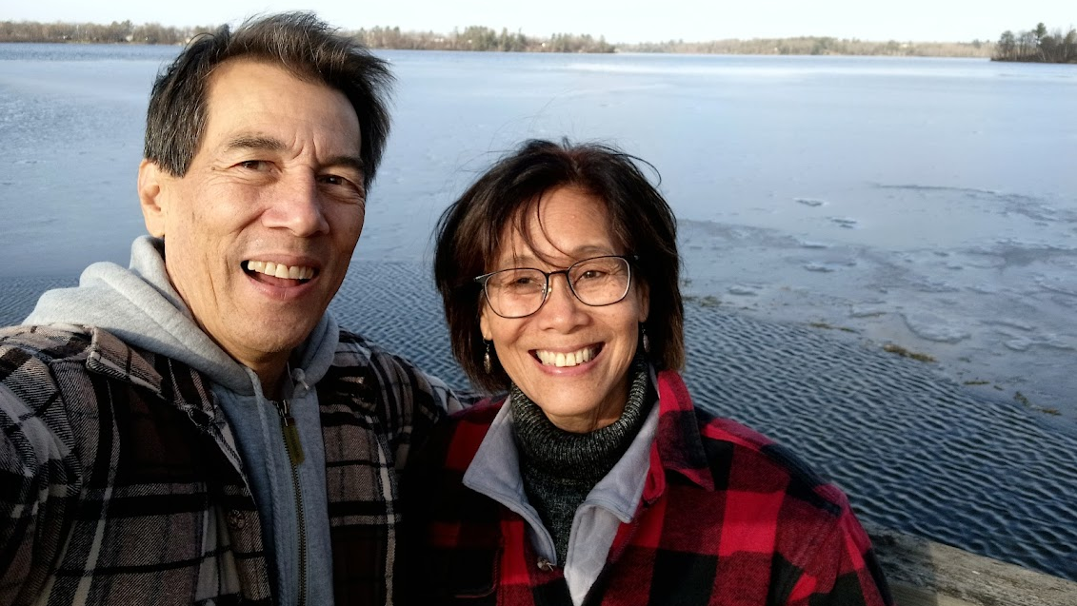

Challenges with Generational Shifts
Notes:
Times have changed. Back in the 50s and 60s, there was a general call to believers in North America to travel to the ends of the earth and bare witness to the good news of Jesus. Young people were inspired by the martyrdom of Jim Elliott and signed up to participate in international mission. Today there is a questioning of the validity of global ministry, especially in light of the concerns about colonialism, the interruption of cultures and unequal power dynamics. For some there is an attitude of cynicism regarding missions.

Slide 3

Organic
Notes:
In the past missionaries went out to share stories about what God was doing around the world. Young people would respond by contacting Covenant World Mission and sign up to serve on the mission field. It just happened organically. But times have changed. Missionaries aren’t invited to speak at churches as much as they were in past. Less people attend church, especially younger generations. There are less avenues available for people to hear the call to international ministry, and even then their views of global ministry can be negative.

Slide 4

Discipleship for Gen Z
Short Bites
Experiential Learning
Coaching
Justice
Explore Spirituality
Notes:
And there is a big desire by churches to disciple young adults, but Gen Z is different than generations before them.
They prefer:
Committing for short periods of time
Learning through participating in ministry experientially
Being coached, and exploring what God is teaching them through their experiences
Ministry with a strong emphasis on Biblical justice
Exploring their spirituality, but not necessarily through the church

Slide 5
The Global Pathway is a discipleship tool for churches to utilize in developing missional leaders and a strategy to recruit and prepare future global personnel.
Notes:
In response, Serve Globally has created this strategic plan.

Slide 6
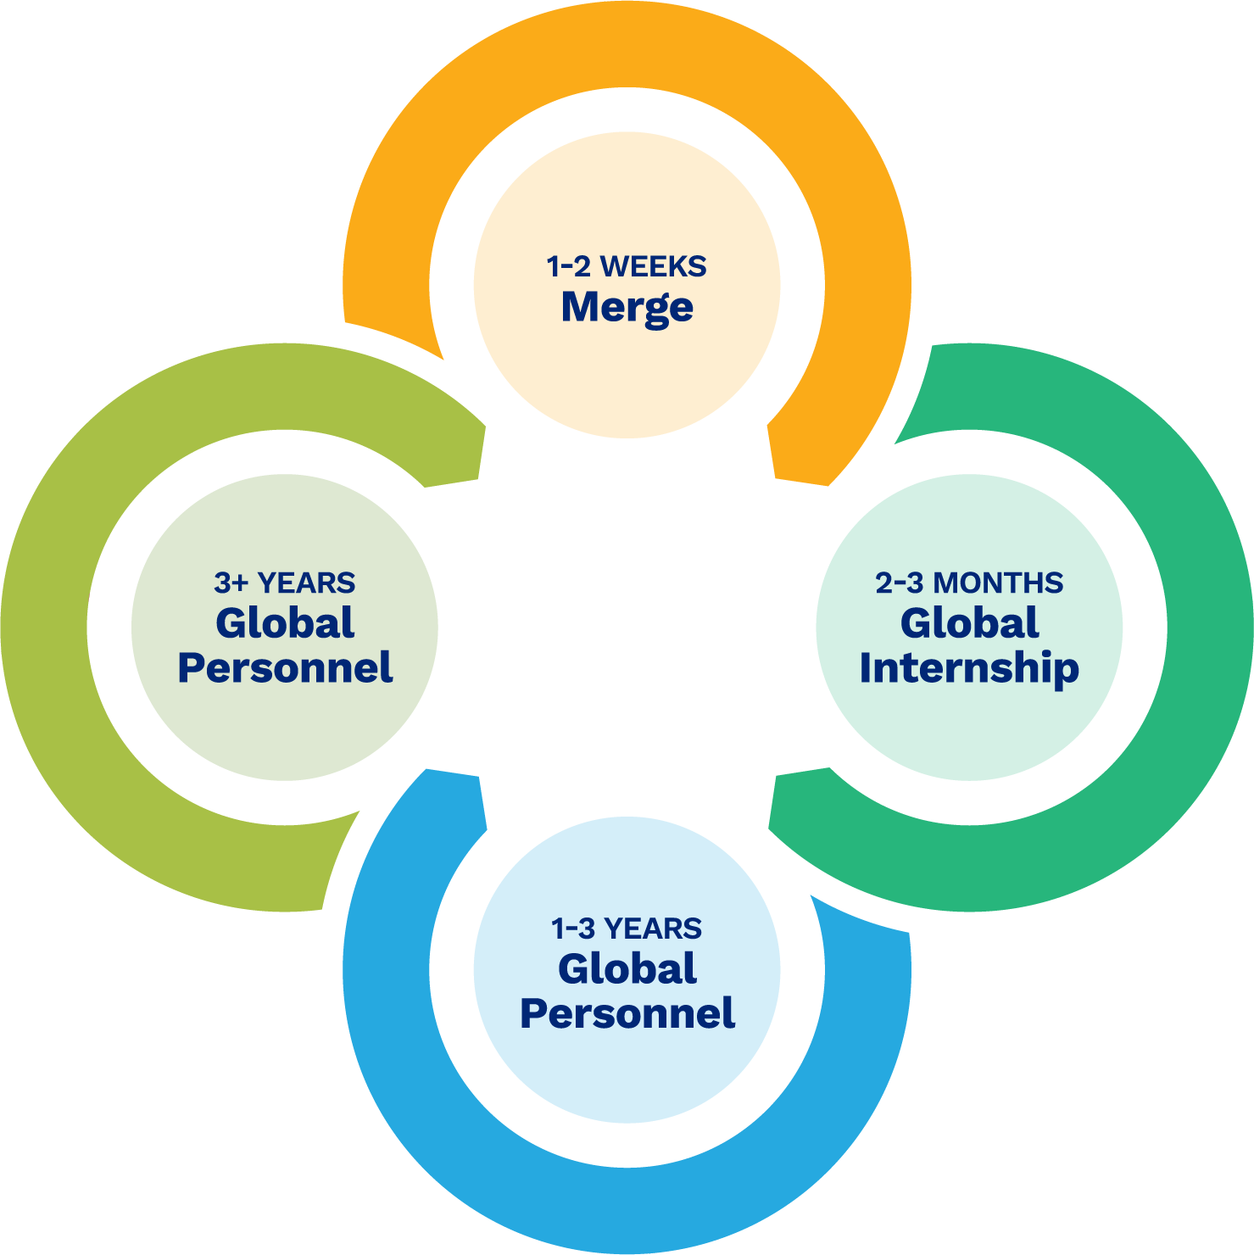
Notes:
The Global Pathway is made up of four components/ministries that are all interconnected.

Slide 7
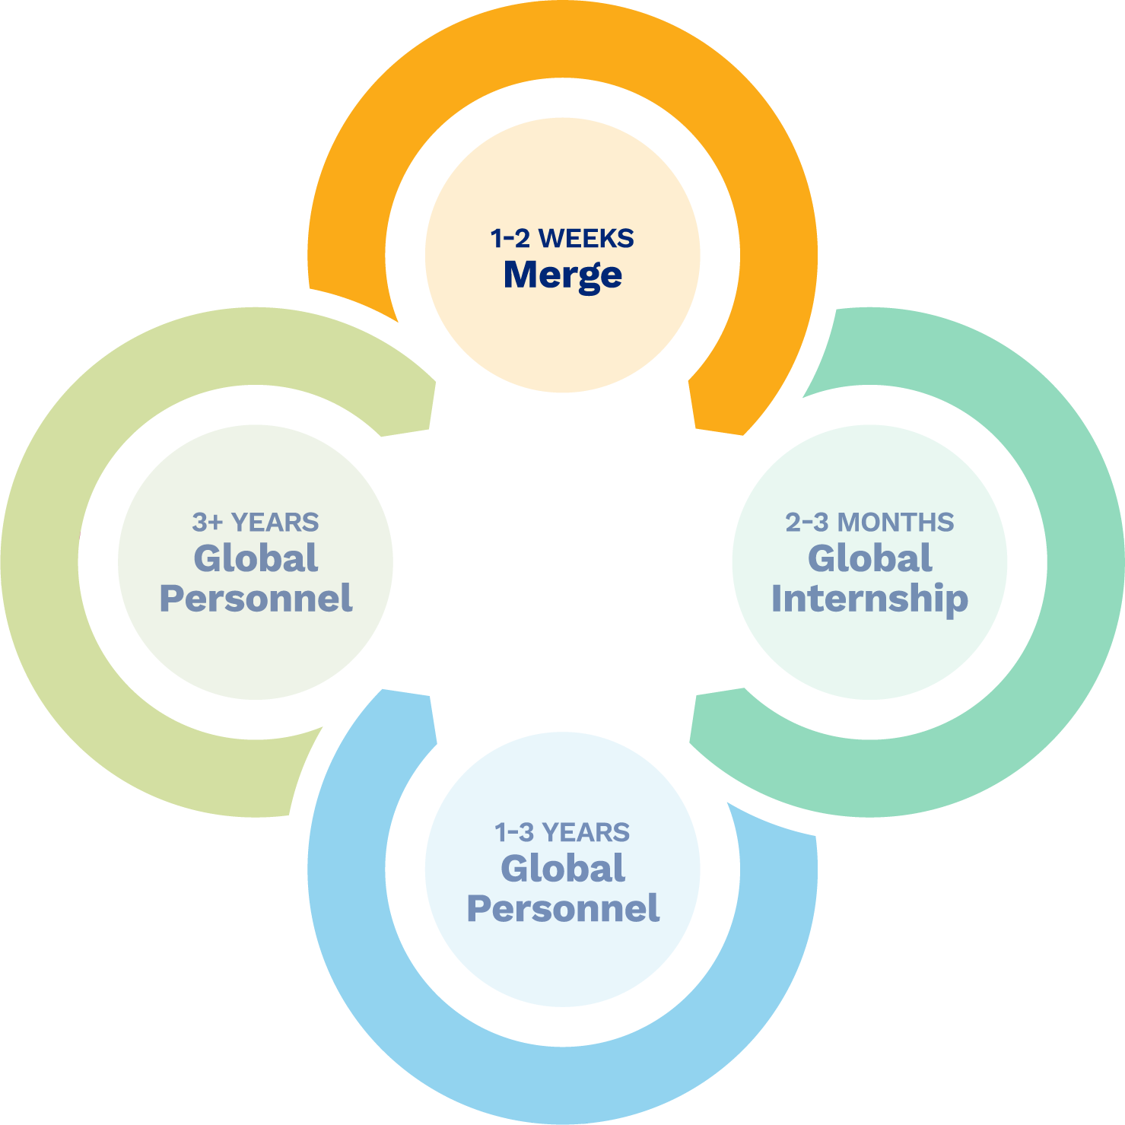

1-2 Weeks
Merge – Short-term Trips
Appropriate and healthy short-term trips with training, preparation and coaching consistent with the entire Global Pathway process.
Notes:
This is the shortest commitment and can involve anyone!
Providing opportunities for people to be involved in global ministry in ways that are missionally appropriate and healthy, through training, preparation and coaching that involve a consistent message shared throughout the entire Global Pathway.
What an individual learns and participates in at this level reflects what even those involved in long-term mission would learn in a basic way.
From these participants our global partners will be asked these questions: "Which of the participants stood out to you?" "Who would you want to do ministry with?" "Who has special gifts for international ministry?”
We invite those individuals to participate in the next step along the path.

Slide 8
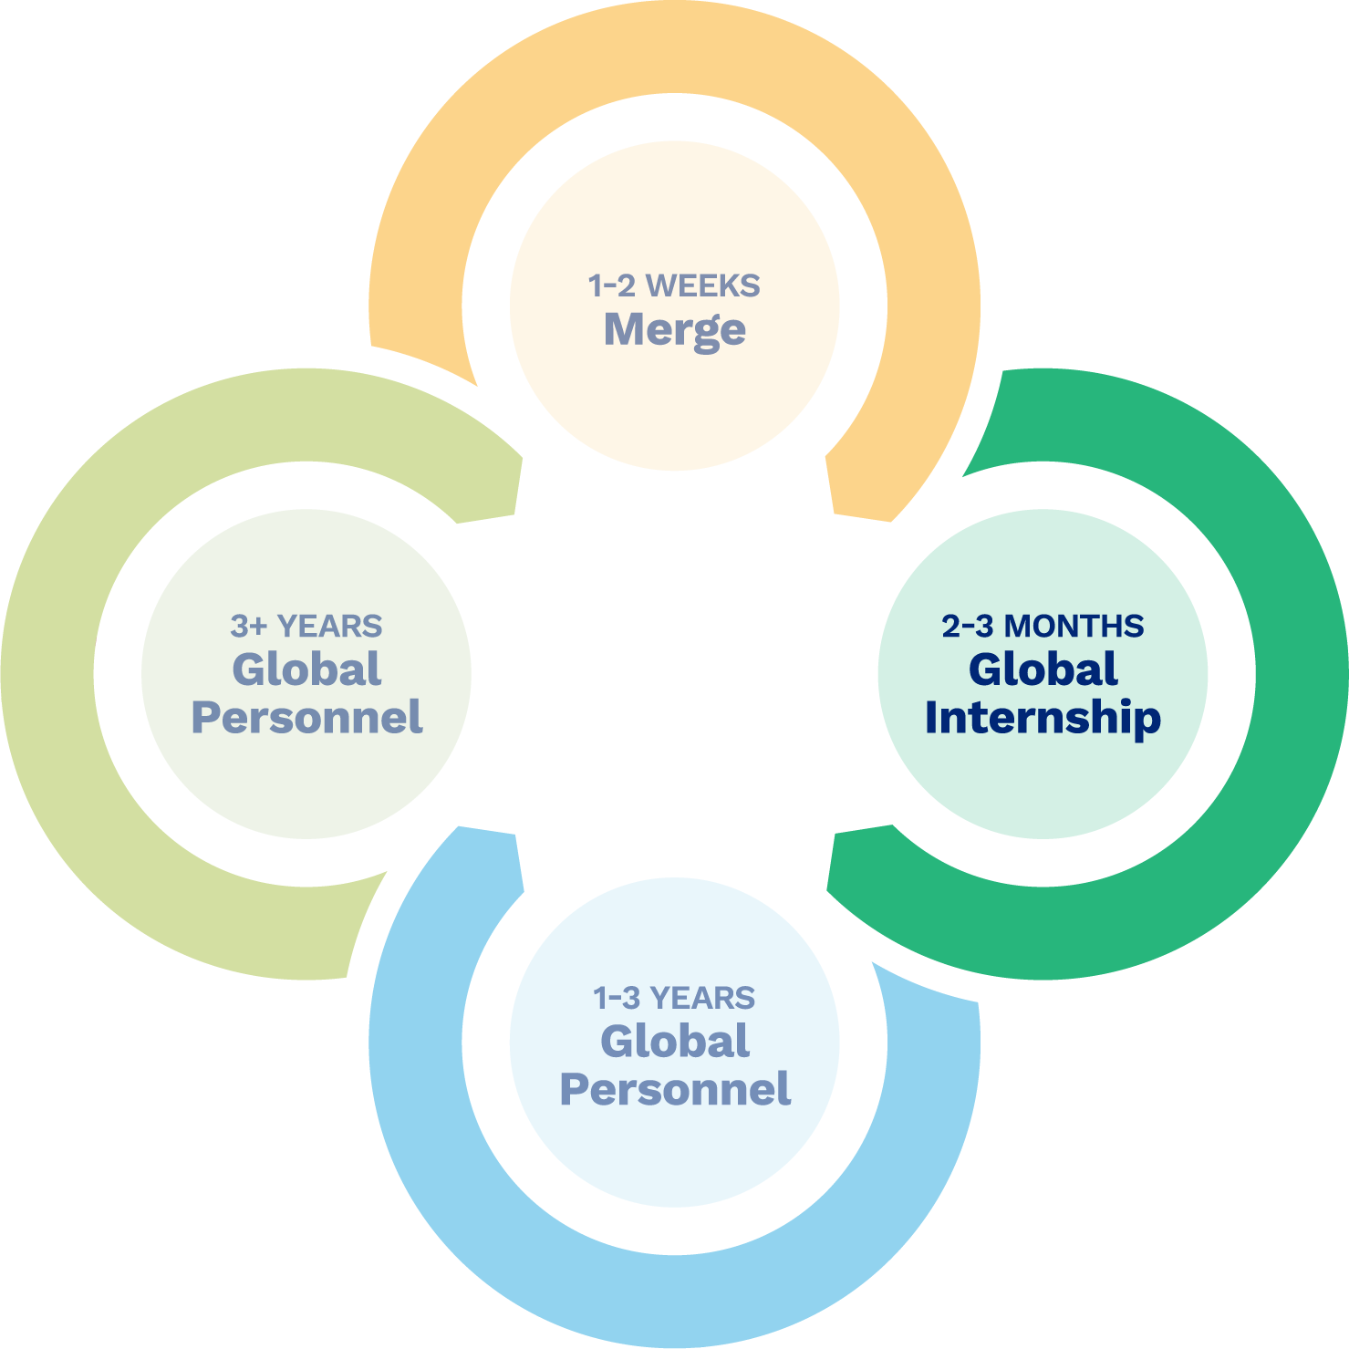

2-3 Months
Global Internship
Learning opportunity through coaching, self-reflection, and experiential learning.
Notes:
Serve Globally is offering a new opportunity for individuals, couples, and families to participate in a 2-3 month internship with our global partners.
The primary focus of the internship is to learn and be discipled.
This will take place through:
Daily reflections, which include readings, prayer, journalling, etc.
Weekly coaching sessions led by Global Personnel
Experiential learning provided by the global church partner

Slide 9
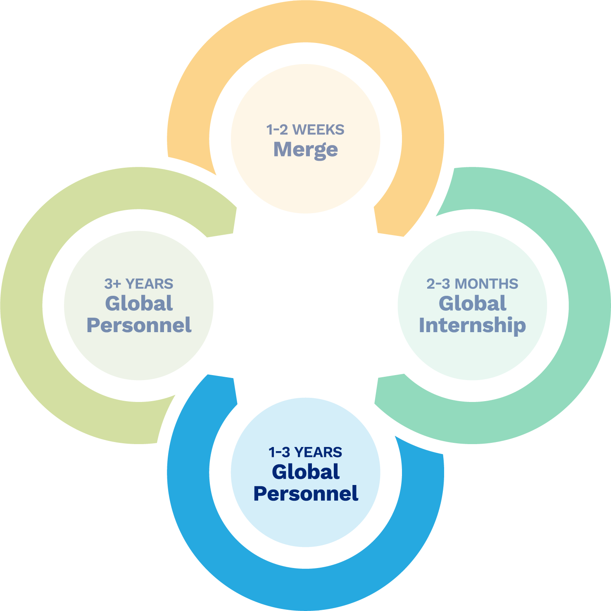

1-3 Years
Global Personnel
Opportunity to utilize skills benefiting global partners while continuing to be discipled and learn with the global church.
Notes:
Serve Globally is offering a 1-3 year opportunity to utilize your skills under the leadership of our global church partners.
Deeper preparation, language learning, and continued discipleship will be a part of this.
Participants will be considered Global Personnel and be placed in a location where their skills will be utilized most.

Slide 10
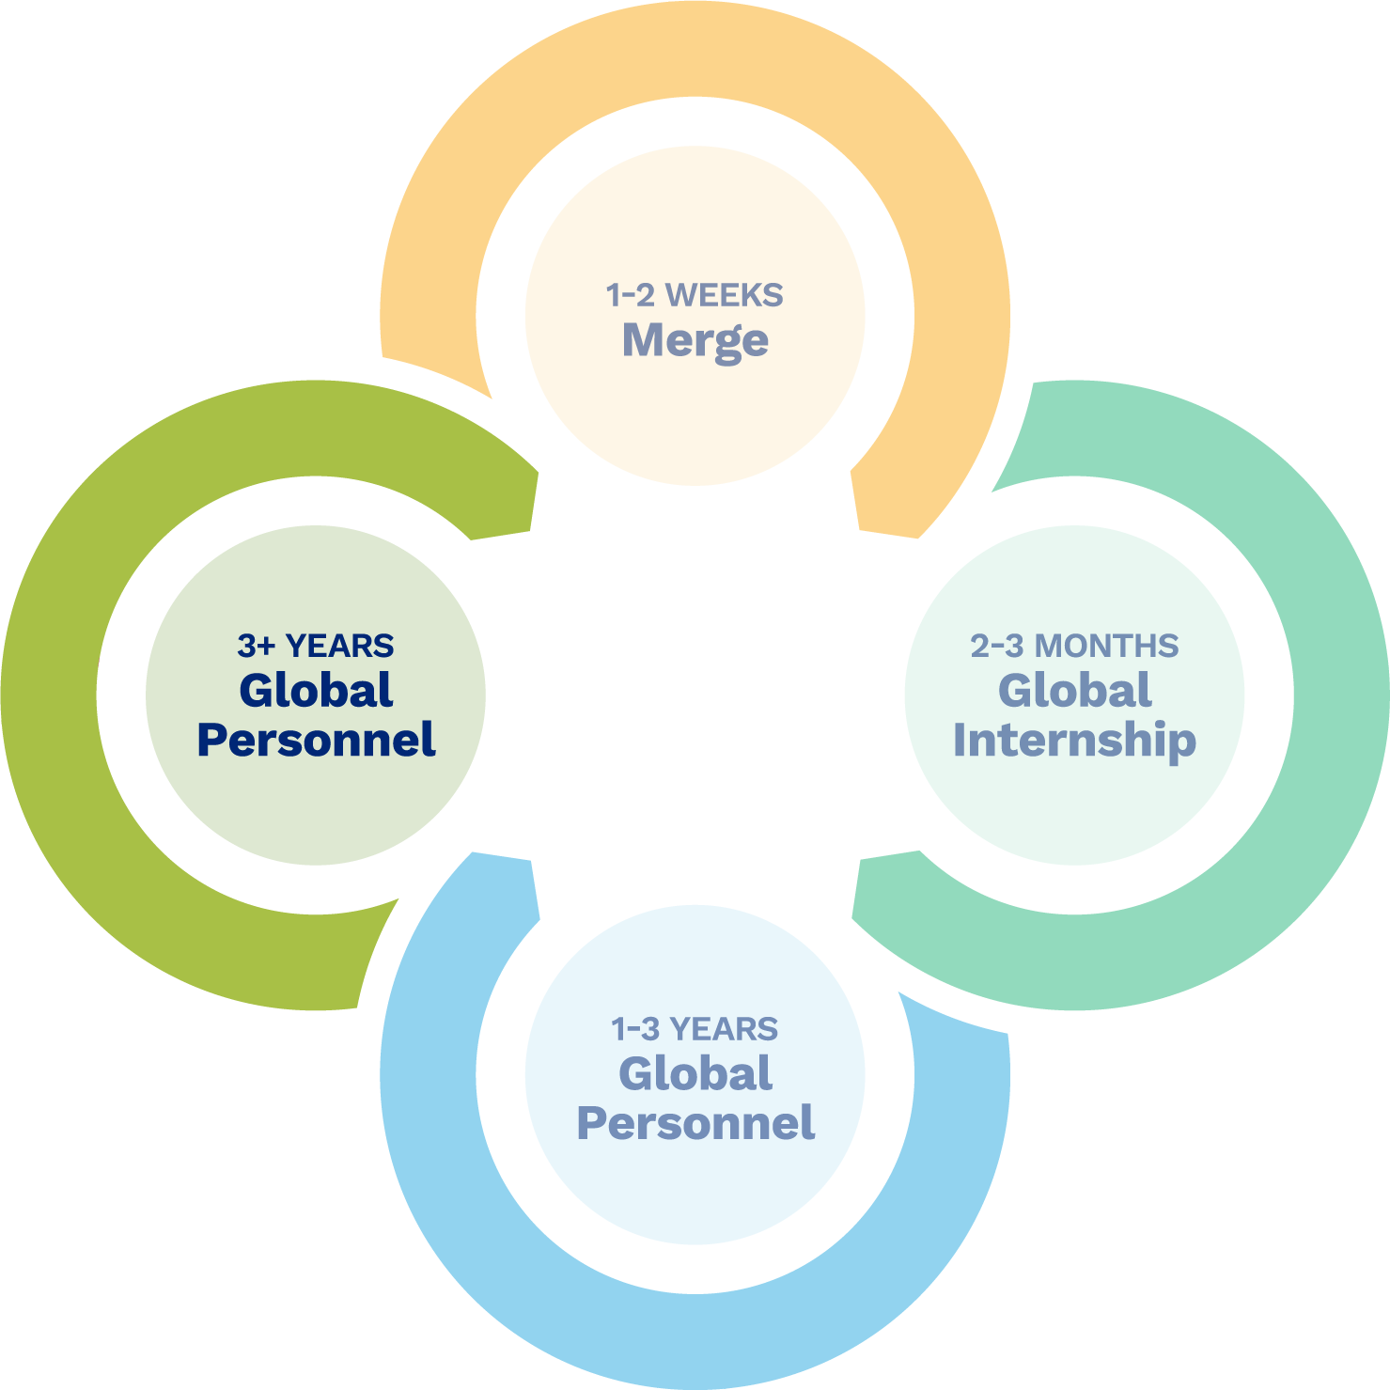

3+ Years
Global Personnel
Response to a call to global ministry as a career.
Notes:
Our hope is the Global Pathway will help the Evangelical Covenant Church to develop the next generation of Global Personnel.

Slide 11
Why the Global Pathway?
Consistent coaching/training/messaging through the process
Incremental learning building on each level
Bite-sized opportunities for people where they are
Better prepared participants interacting with global partners in healthier ways
Global church input and coaching
Experiential learning and coaching
Discernment process — What is God’s call on your life?
Church members discipled by the global church leading to a wider and more robust understanding of who God is and how God works in this world
Notes:
As participants in the Global Pathway have walked through the different levels of the pathway, they will be more prepared to serve in a global ministry career.
Along the path they will have experienced:
Consistent coaching/training/messaging through the process – What someone learns at 1-2 weeks is reflected in the learning everyone receives throughout the pathway
Incremental learning building on each level – Each level learns more in-depth understanding of global ministry and missiology; each level builds in the other
Bite-sized opportunities for people where they are – Different time commitments allow for the pathway to fit in people’s ability to participate
Better prepared participants interacting with global partners in healthier ways – Learning incrementally is the best way to grow future Global Personnel
Global church input and coaching – The global church leaders are asked for their input into what participants are best gifted to move along the pathway; the question is asked “who do YOU want to do ministry with?”
Experiential learning and coaching – learning by doing
Discernment process — What is God’s call on your life? – Post participation debriefing with Serve Globally staff as to what come next
Church members discipled by the global church leading to a wider and more robust understanding of who God is and how God works in this world – As our ECC church members engage with the global church they will be challenged to discern what God’s call is for them in their own community and cultural context

Slide 12
Who Is It For?
Individuals
Couples
Families
Notes:
The Global Pathway is for individuals, couples, and families--Everyone is invited!

Slide 13
Desired Outcomes
Our desired outcomes are bi-directional and EITHER ONE IS A WIN!
The Church and Serve Globally win when Global Pathway participants return home with increased passion for Christ, a deeper commitment to ministry in their church and community, and a greater understanding of what God is doing around the world through the global church.
The Church and Serve Globally win when Global Pathway participants continue along the path learning, growing, and preparing to be the future global personnel of our denomination.
Notes:
From utilizing the global pathway and by developing missional leaders both outcomes serve the Church and Serve Globally.

Slide 14

Notes:
We encourage you and your church to join Serve Globally on the Global Pathway!

Slide 15
Thank you

